Slide 1
How can enabling conditions help rural livelihoods benefit from urbanising food systems?
Notes:
Urbanisation is a driver of changes in food systems. The following slides consider how urbanisation changes food systems, and what is required to make rural livelihoods benefit from these changes.

Slide 2
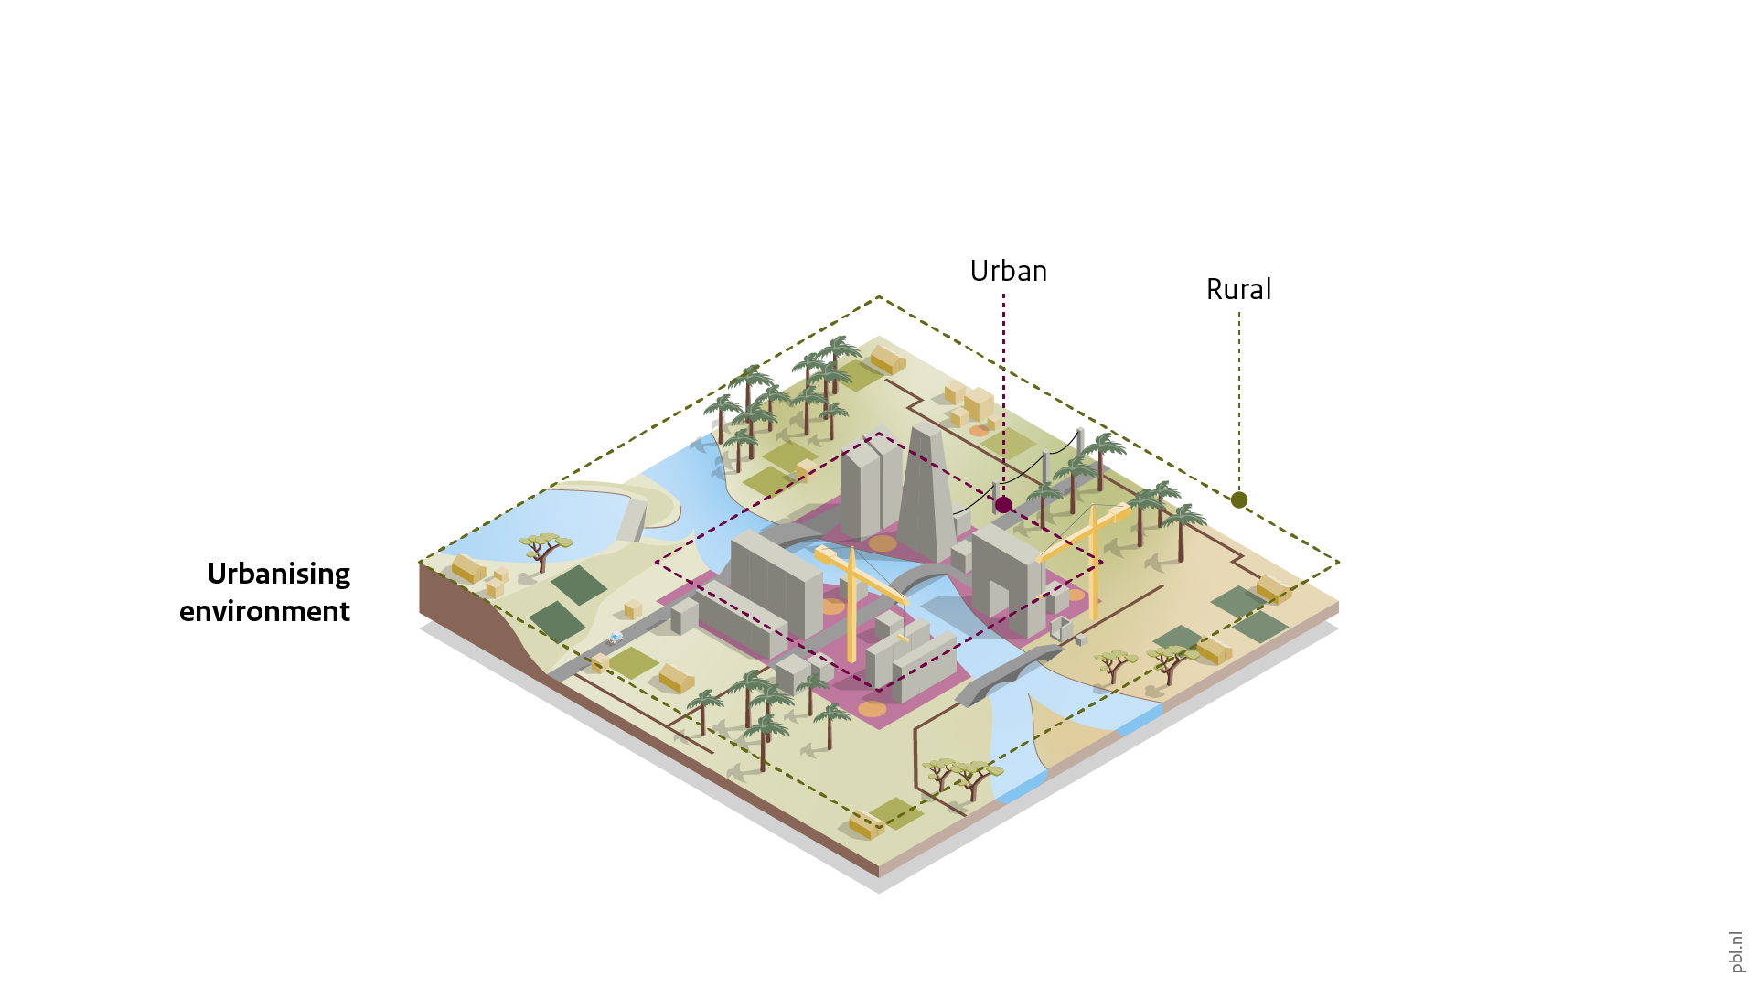
Urbanisation, food systems and rural development
Notes:
There are several ways in which urbanisation changes food systems. Urbanisation leads to a growing urban food demand, due to the increasing number of people living in cities. Towards 2050, global urban food demand is expected to grow two to four times faster than rural food demand. Urbanisation also changes market linkages. A more diverse and larger urban demand changes food values chains. It creates an increased need for transport, storage, processing and marketing of food. Furthermore, urbanisation comes with changing land use around growing cities. Peri-urban agriculture disappears or moves further away from the city. Furthermore, urbanisation leads to a changing and more diverse demand for food. These changes can be attributed to:
Different urban food cultures: people in cities may change their dietary preferences.
Higher incomes (for some urbanites): people in cities may be able to buy food that was previously out of their price range.
More diverse availability: because cities present a larger market, there may be products for sale that are not available in rural areas.
These changes can affect rural development in different ways, bringing both opportunities and risks to rural people working in food systems.

Slide 3
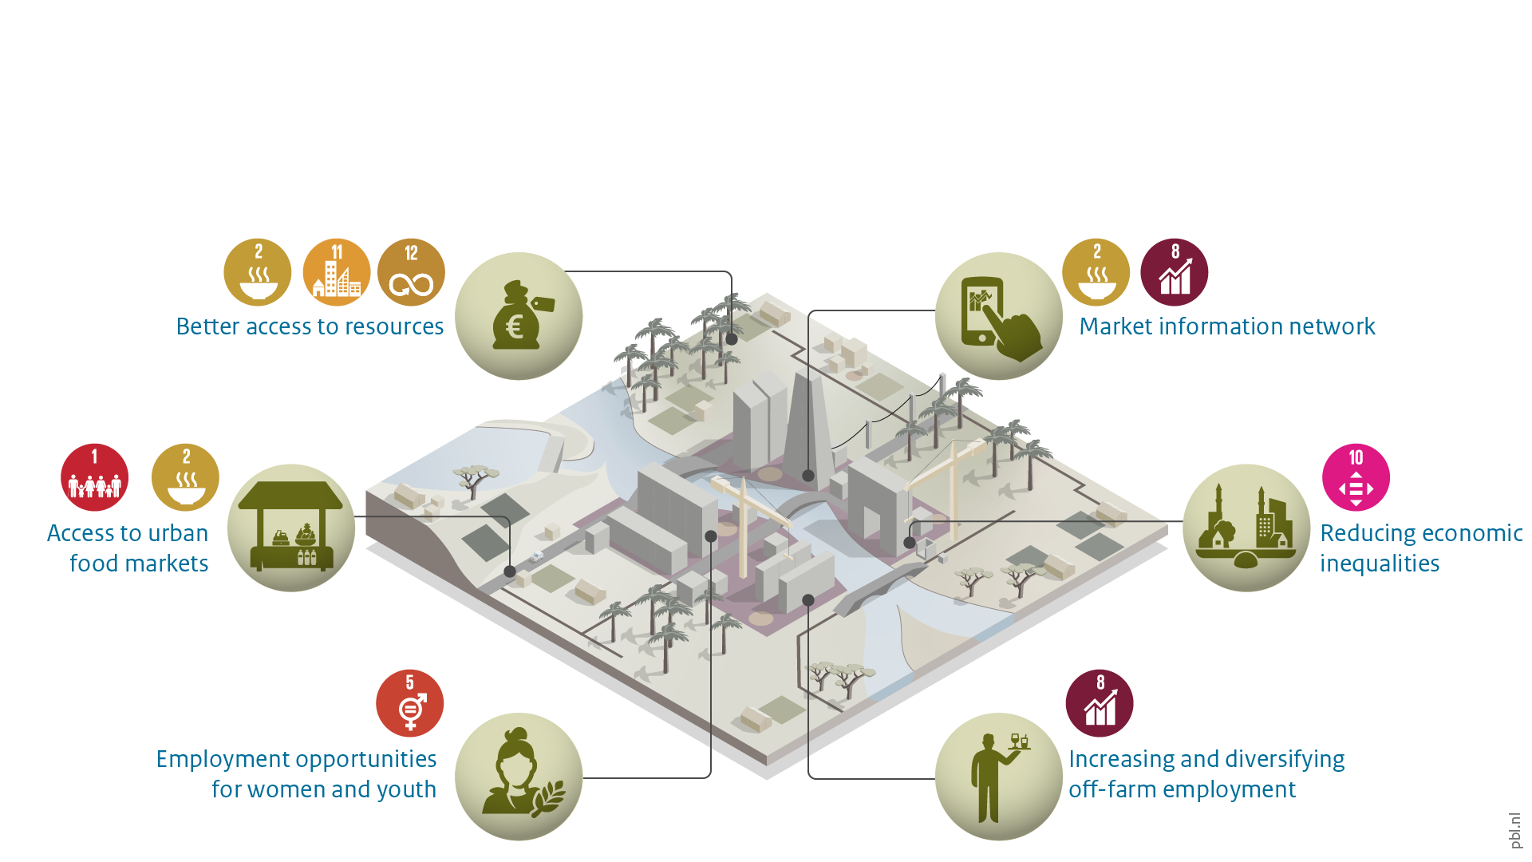
Opportunities for rural development
Notes:
Opportunities for rural livelihoods include the following examples.
For farmers who are well-connected to growing cities, opportunities entail better access to farming resources, such as fertilizers, seeds and financial services. This may increase their income. For this group, being well-connected to urban food markets reduces travel time, increasing farm income. In addition, urbanisation often comes with improved communication systems. This creates an opportunity for farmers and food traders, because access to market information can improve the timing for selling their produce, thus, increasing income.
The more diverse food demand increases off-farm employment opportunities in trading, storing, processing and marketing food. This can create additional opportunities for youth and women.
When urbanisation is happening across a country, also in secondary and tertiary cities, rather than being centred in one or two mega cities, economic inequalities between rural and urban areas can be reduced.

Slide 4
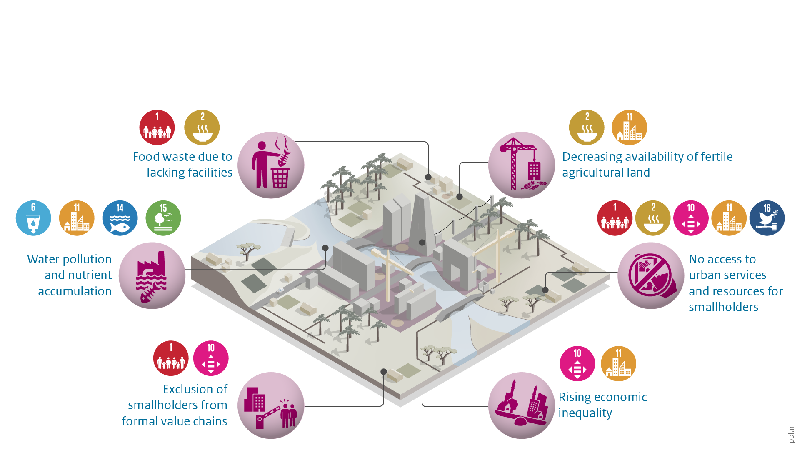
Risks for rural development
Notes:
At the same time, urbanisation and its effects on food systems can come with risks for rural development. Examples of such risks include:
When there are limited facilities to store and market food, food waste can increase in cities, decreasing farmer income.
Urbanisation can lead to pollution, especially in cities where sanitation is limited. The ensuing nutrient accumulation can negatively affect farmers around or downstream cities.
The formalisation of food value chains often forms a risk for smallholders, because they tend to face higher requirements regarding the efficiency and minimal purchase volume. This can make it more difficult for small farmers to sell their produce in urban settings.
The physical effects of urban expansion pose another risk. Because land rights are not always well-accounted for, farmers close to an expanding city may lose their land. Sometimes farmers are forced to relocate, and sometimes farmers are forced to stop farming and change their livelihoods.
Small farmers who are not well connected to the growing urban markets lack access to resources (farming inputs) and urban services (market information, financial services), putting them in a disadvantaged position, compared to farmers who can act on the opportunities that urbanisation creates.
Economic inequality may increase because of the differences in who can profit from urbanisation and who cannot. Especially, when megacities are growing but small- and medium-sized cities are not, inequality can increase, as a lack of connectivity causes few rural people to profit from the opportunities offered by these megacities.

Slide 5
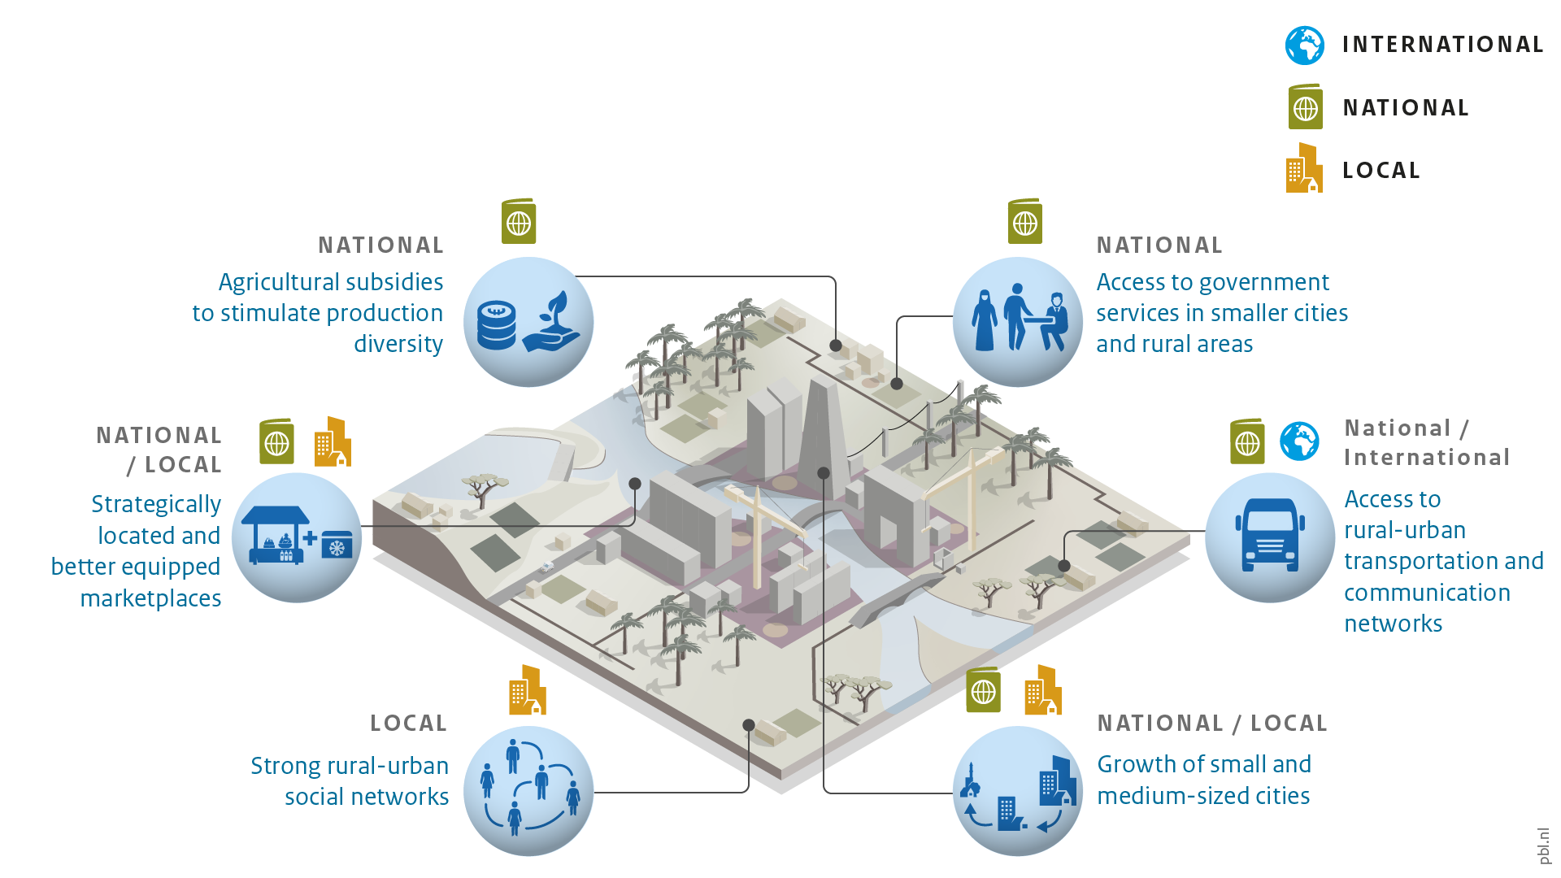
Enabling conditions
Notes:
So-called enabling conditions can be implemented that stimulate the opportunities and limit the risks, for all rural actors. These enabling conditions can be found in several sectors, ranging from spatial planning, education and agriculture to finance. Some of these enabling conditions can be implemented on local or national scales, while others may require global action.
The slide provides six examples.
Agricultural subsidies can stimulate farmers to grow more diverse produce, adapting to urban demand. Today, subsidies on cultivating staples are contributing to unbalanced diets, as they keep related market prices low compared to other more diverse products.
The location and equipment (e.g. cooling) of food markets can enable access to urban food markets for rural actors.
Strong rural–urban social networks allow farmers to adequately adjust their production to a changing urban demand and to grasp urban employment opportunities.
Providing government services (e.g. social security, training courses) in smaller cities and rural areas makes farmers better equipped to act on the changes that come with urbanisation.
Small and medium-sized cities have important functions for both the rural hinterlands as well as the larger cities. Nearby, small cities improve access to urban markets for rural households. This contributes to raising productivity and efficiency, which in turn increases income.
(For more information on enabling conditions, see: Urbanisation as driver of food system transformation and opportunities for rural livelihoods)

Slide 6
Enabling conditions on multiple levels
Notes:
The array of enabling conditions that can contribute to sustainable rural livelihoods link to each other on multiple scales and mostly work in conjunction with each other. To make urbanisation work for rural livelihoods, an integrated approach is needed on different levels, which addresses multiple scales and various actors.
Bottlenecks that hinder rural livelihoods in benefitting from urbanisation may differ per situation. Both global and local action is required, from investments in government services (e.g. social security and capacity-building programmes) and facilitating access to inputs and markets on the local level, to national spatial development plans and inclusive trade agreements on the global level.

Slide 7
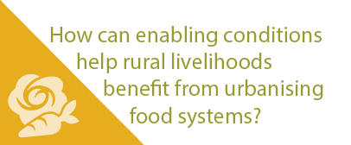
More stories at pbl.nl/ig22
This presentation

