Slide 1
What is the potential of land restoration for delivering multiple benefits?
Notes:
Land restoration has the potential to deliver multiple environmental and societal benefits, simultaneously, making it a highly integrated solution for sustainable development.

Slide 2
Land restoration: Possible measures
Notes:
First of all, what does land restoration mean? Land restoration covers a range of measures that improve natural ecosystems and rehabilitate lands used by humans. Such measures restore land that is degraded, meaning it has undergone a decline in land condition and persistent loss of ecosystem functions due to direct or indirect human-induced processes that cannot be reversed unaided. Examples of restoration measures include:
Agroforestry: a type of agriculture that combines trees and crops, or trees and pasture, on the same plot, improving carbon sequestration, water-holding capacity and biodiversity, compared to conventional agriculture.
Forest plantation: planted forests, usually intensively managed and highly productive monocultures. Plantation forests can contribute to climate change mitigation and be a source of fuel and materials, if managed to take into account environmental impacts and local stakeholders.
Assisted natural regeneration: a forest restoration method that enhances the growth in semi-natural forest by acceleration natural processes.
Organic amendments: substances added to the soil to improve its physical properties, such as fertility and water holding capacity.
Grazing management: reducing overgrazing and improving forage production to maintain healthy and productive pastures.
Grassland improvement: the introduction of local or exotic grasses and legumes to improve grassland productivity, which can lead to increased soil health.
Conservation agriculture: managing agricultural land, for example by improving residue management and reducing tillage, to prevent land degradation and increase efficiency in the use of resources, while supporting profitable agricultural practice.
Cross-slope barriers: soil and water conservation measures on sloping land.
(For more information on land restoration measures, see https://themasites.pbl.nl/nature-based-solutions/; for more on the definition of land degradation and restoration: https://www.pbl.nl/en/publications/the-global-potential-for-land-restoration-scenarios-for-the-global-land-outlook-2)

Slide 3
Land restoration benefits multiple SDGs
Notes:
Land restoration has the potential to deliver multiple benefits, simultaneously, making it a highly integrated solution for sustainable development. The way that land is used, managed and protected is central to achieving the goals of the UN Conventions on land degradation and desertification, climate change and biodiversity, as well as many of the Sustainable Development Goals. This is because the choices, synergies and trade-offs between sustainability ambitions often materialise on land. Over the past years, attention for and ambitions on restoration have gained momentum, culminating in the UN Decade on Ecosystem Restoration (2021–2030).

Slide 4
Potential benefits of land restoration
Notes:
In 2021, PBL quantified the potential effects of land restoration at global and regional levels, on various ecosystem services, up to 2050. The effects of land restoration were assessed with respect to remaining natural land, biodiversity, soil organic carbon, agricultural yields, water regulation and carbon storage. This slide and the next one show the effects of restoration compared to a baseline scenario, meaning they show the potential of restoration by 2050, compared to a future without restoration.
(For more information on the potential benefits of land restoration, see https://www.pbl.nl/en/publications/the-global-potential-for-land-restoration-scenarios-for-the-global-land-outlook-2)

Slide 5
Potential benefits of land restoration
Notes:
For the indicators on remaining natural land, biodiversity, and carbon storage, there is still a decline in the restoration scenario compared to today. However, under the restoration scenario, this decline is smaller than without restoration (i.e. under the baseline scenario). For soil organic carbon, crop yield and water regulation, restoration measures not only have a positive impact, relative to the baseline, but also when compared to the situation of today.
(For more information on the potential benefits of land restoration, see https://www.pbl.nl/en/publications/the-global-potential-for-land-restoration-scenarios-for-the-global-land-outlook-2)

Slide 6
Restoration commitments and scenarios
Notes:
Many countries have made commitments about their restoration ambitions. Current global restoration commitments cover around one fifth of the potential area that could be restored according to the PBL scenarios. Almost half of all commitments are found in Sub-Saharan Africa. There are also large commitments in South Asia and Central and South America, relative to the total land area. Other regions report much smaller commitments to land restoration.

Slide 7
Multiple but fragmented benefits
Notes:
The multiple benefits of restoration draw in a variety of actors but can result in fragmentation, making investment decisions complex. Fragmented planning, funding and implementation are underscored by the lack of coherence between national plans for land restoration.

Slide 8
Combining fragmented benefits
Notes:
Knowledge on effective policy and governance approaches to bridge this complex distribution of costs and benefits remains scarce. A starting point could be provided through integrated landscape management, which refers to a long-term collaboration between different groups of land managers and stakeholders to achieve multiple objectives.

Slide 9
Combining fragmented benefits
Notes:
Integrated landscape management aims to integrate the objectives of different stakeholders at landscape level, in order to establish long-term sustainable growth. Landscape approaches can lead to improved cross-sectoral decisions that are better than the sum of actor- and sector-specific solutions.

Slide 10
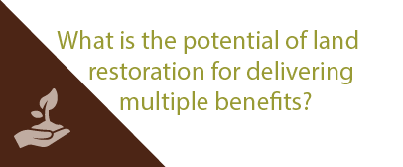
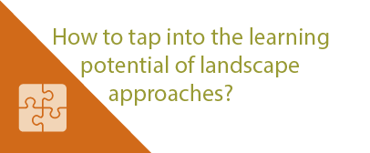
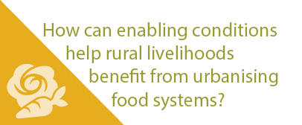
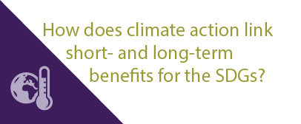
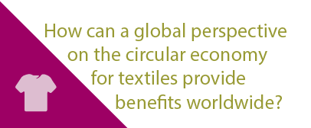
More stories at pbl.nl/ig22
This presentation

